Slide 1
HSE Management Standards
Janet Heath

Slide 2
What is stress?
“the adverse reaction people have to excessive pressures or other types of demand placed upon them”
(Health and Safety Executive GB)

Slide 3
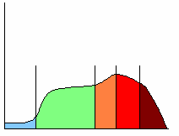
Performance Curve
High
Performance
Stretch
Strain
Comfort
Breakdown
Boredom
Low
Minimum
Maximum
Level of Pressure

Slide 4
Why manage stress?
Legal
Health and Safety at Work Order
Management of Health and Safety at Work Regulations
EU Directive 89/391
Management standards
Moral
Links between stress and pre existing medical conditions
Poor coping strategies
Financial
10.4 million working days lost (2011/12 - work-related stress) (LFS)
Each case of work-related stress leads to an average of 24 working days lost
Presenteeism - reduction in productivity (as high as 33%) that occurs when employees
come to work but function at less than full capacity because of stress/ill health (HSE)

Slide 5
How
Primary interventions
Stress Risk Assessment
Stress Policy
Flexible work/ improved work life balance
Secondary interventions
Stress management training
Systems for employees to raise concerns
Tertiary interventions
Employee assistance programmes/counselling
Greater involvement of occupational health specialist

Slide 6
Management Standards Approach
What are the Management Standards?
The management standards are a set of conditions that if managed correctly in organisations, can reflect high levels of health and wellbeing and organisational performance.

Slide 7
How? Risk Assessment Approach

Slide 8
Step 1 – Identify the hazards Management Standards
Demands - Includes issues like workload, work patterns, and the work environment
Control - How much say a person has in the way they do their work
Support - Includes the encouragement, sponsorship and resources provided by the organisation, line management and colleagues
Relationships - Includes promoting positive working to avoid conflict and dealing with unacceptable behaviour
Role - Whether people understand their role within the organisation and whether the organisation ensures that the person does not have conflicting roles
Change - How organisational change (large or small) is managed and communicated in the organisation

Slide 9
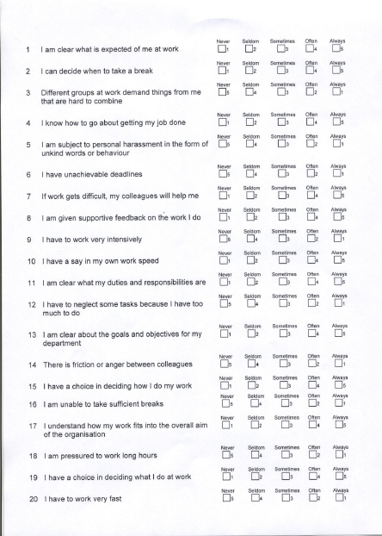
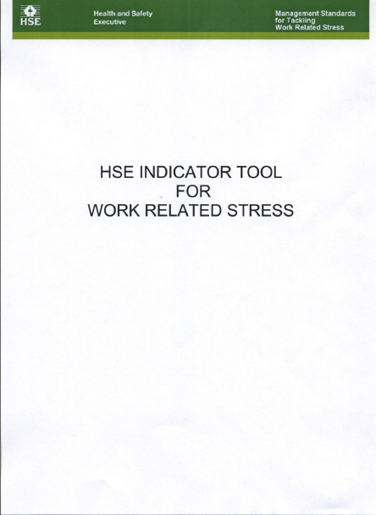
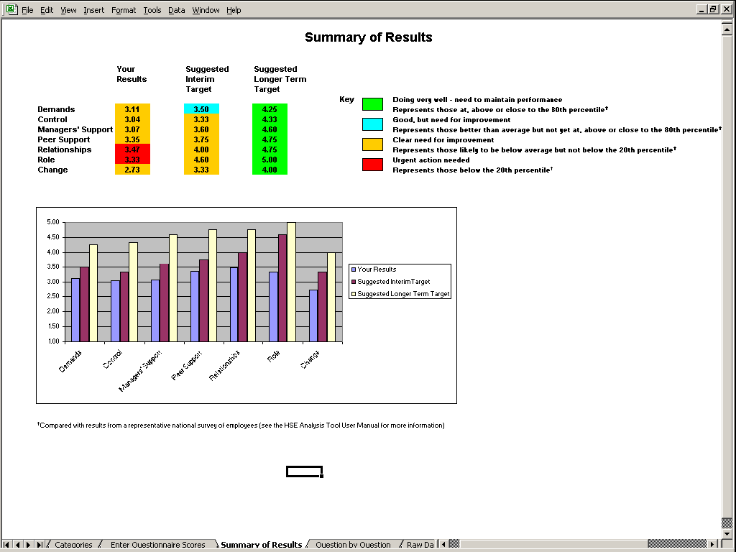
Step 2 – Who can be harmed and how?

Slide 10
Step 3 – Evaluate the risk Focus Groups

Slide 11
Step 4 – Record your findings Steering Group/Action Plan

Slide 12
Step 5 - Monitor and Review

Slide 13
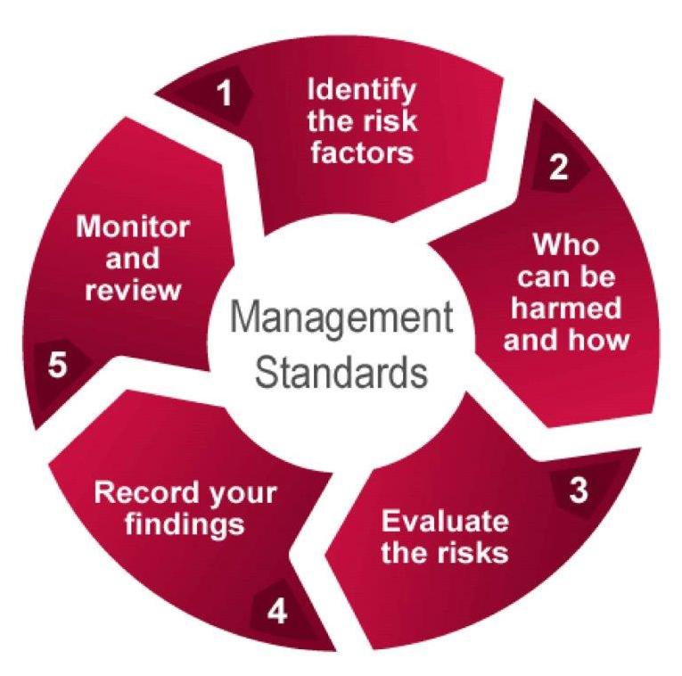
How HSENI facilitate the Risk Assessment Process
HSE Management Standards
Survey staff using HSE Indicator tool (35 multiple choice questions?
Steering Group
Implementation plan
Continuous improvement
Draft report concerns raised/potential solutions
Facilitate Focus Groups

Slide 14
Benefits
HSE Management Standards
demonstrate good practice through a step by step risk assessment approach
allow assessment of the current situation using surveys and other techniques
promote active discussion and working in partnership with employees to help decide on practical improvements that can be made
Reduce sick absence
Long term wellbeing of staff
Benchmark performance
Compliance with the law

Slide 15
Useful links
http://www.hse.gov.uk/stress/standards/downloads.htm
Link to HSE Management Standards – tools and templates
http://www.businessmentality.org.uk/stress-check-tool
Link to Business Mentality 5 Minute stress check
http://www.hse.gov.uk/stress/mcit.htm
Link to Line Manager Competency Indicator Tool
http://www.hseni.gov.uk/resources.htm?srch_topic=6090
Link to HSENI website tools and templates

